Slide 1


Department of Artificial Intelligence and Data Science
Real-Time AML Suspicious Pattern Clustering
Mr.Subramanian k PROFESSOR
AI&DS
MTHULAKSHMI M - 231801114
RAMYA A - 231801135
MEENAKSHI G -231801099

Slide 2
INTRODUCTION
Title:Real-Time AML Suspicious Pattern Clustering
Problem Statement
Financial institutions struggle to detect hidden suspicious transactions due to the limitations of traditional rule-based and manual systems. These systems often miss evolving fraud patterns and produce many false alerts.
Objective
To build a real-time, data-driven AML detection system that identifies suspicious transaction clusters using big data analytics and machine learning, improving accuracy and response time.
Proposed Solution
A DBSCAN-based clustering model implemented on Databricks analyzes large transaction datasets, detects anomalies, and visualizes insights through interactive dashboards for better fraud monitoring and decision-making.

Slide 3
Abstract
This project aims to enhance the detection of suspicious financial transactions in the banking sector using Big Data and Machine Learning techniques. Traditional rule-based AML systems are limited, as they depend on predefined conditions and fail to adapt to evolving fraudulent behaviors. To address this challenge, the proposed system utilizes the DBSCAN clustering algorithm on the Databricks platform to analyze large volumes of transaction data efficiently. The system identifies hidden patterns and groups normal and abnormal transactions based on their similarity, helping to uncover potential money laundering activities. Processed outputs are visualized through interactive dashboards, enabling analysts to monitor high-risk regions, transaction trends, and channels in real time. This approach improves fraud detection accuracy, minimizes false positives, and empowers financial institutions to make faster and more data-driven compliance decisions.

Slide 4
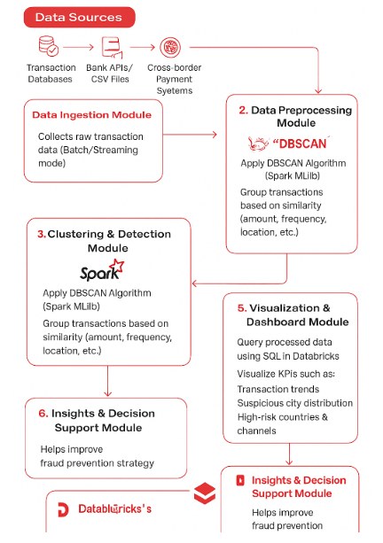
SYSTEM ARCHITECTURE
4

Slide 5
Modules Overview
Bronze Layer: Ingest raw financial transaction data (event_id, time, city, account_id, country, amount, etc.). Silver Layer: Clean, normalize, and preprocess data — handle missing values, format timestamps, and encode categorical variables. Gold Layer: Apply DBSCAN clustering to detect suspicious transaction patterns and tag anomalies.
Processing: Performed using PySpark and SQL within Databricks for scalability and speed. Storage: Managed through Delta tables for reliable and versioned data handling. Visualization: Interactive dashboards built in Databricks / Power BI showing anomalies, city trends, and cluster summaries.
Flow: Data Ingestion → Preprocessing → Clustering (DBSCAN) → Anomaly Detection → Visualization
Outcome: → Automated detection of suspicious transactions with real-time insights, → Enhanced fraud monitoring and AML decision-making through data-driven intelligence.

Slide 6
Tools Used
Cloud Platform: Microsoft Azure / AWS (for Databricks deployment)
Data Processing: Apache Spark (via Databricks) for scalable big data analytics
Data Storage: Delta Lake for reliable, optimized cloud storage
Programming & Scripting: Python (PySpark, Pandas, NumPy) for data manipulation and logic building
Machine Learning: MLflow for model tracking, versioning, and performance management
Visualization: Databricks Dashboards / Power BI for interactive data insights
Version Control: GitHub / Databricks Repos for seamless collaboration and version tracking

Slide 7
Implementation
Data Collection: Gathered all the raw data from different sources.
Data Cleaning: Removed errors, duplicates, and missing values using PySpark.
Data Storage: Stored the data in different layers (Bronze, Silver, Gold) in Delta Lake.
Data Processing: Transformed and organized the data for analysis.
Model Building: Used machine learning in Databricks to find useful patterns and insights.
Visualization: Created dashboards in Databricks / Power BI to show results and trends clearly.

Slide 8
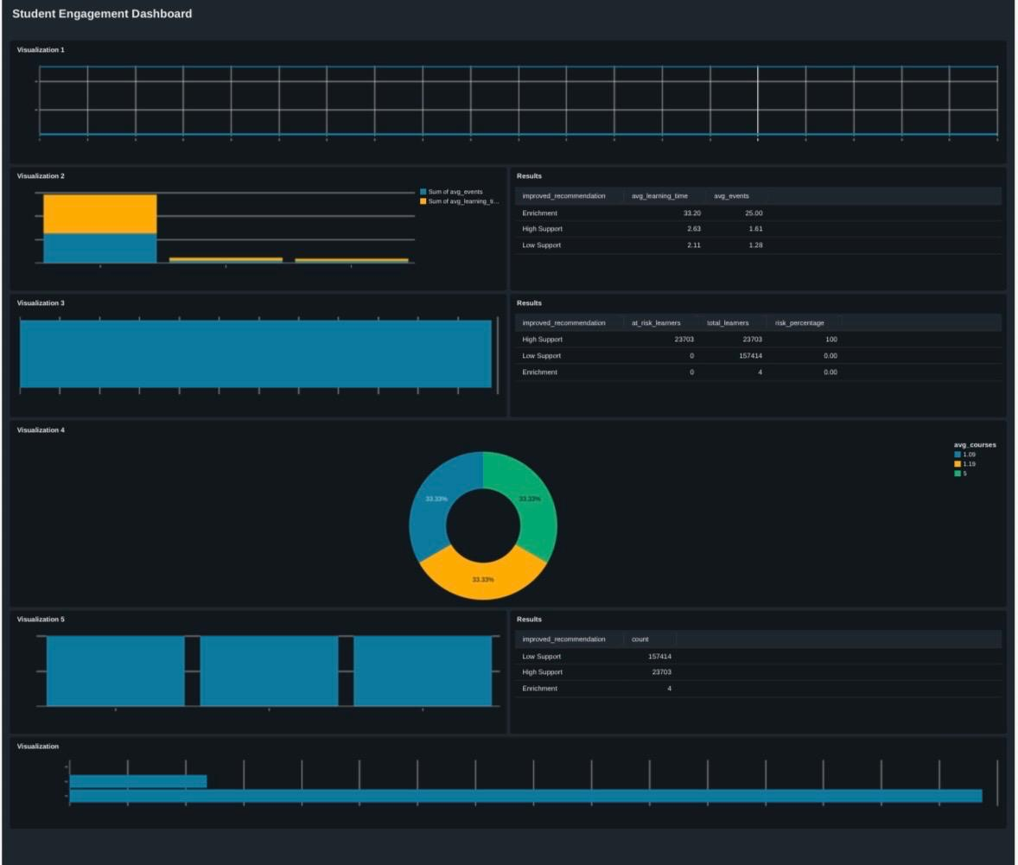
DashBoard Visualization

Slide 9
Results
The system successfully analyzed and clustered the data using DBSCAN in Databricks.
Outliers and key patterns were identified effectively from large datasets.
The visual dashboards displayed insights clearly, helping in better decision-making.
The clustering results showed strong relationships and anomalies within the dataset.
Overall, the project proved the efficiency of Databricks for large-scale data processing and visualization.

Slide 10
Conclusion and Future Scope
Conclusion
The project successfully detected suspicious transactions using clustering techniques.
Databricks provided a unified platform for data processing and visualization.
The dashboards helped identify transaction patterns and anomalies effectively.
Overall, the system improved financial monitoring and decision-making efficiency.
Future Scope
Integrate real-time transaction monitoring for instant fraud detection.
Implement advanced AI models for more accurate anomaly detection.
Add automated alerts and notifications for high-risk transactions.
Expand visualization with interactive dashboards and drill-down analytics.

Slide 11
Reference
Apache Spark Documentation: https://spark.apache.org/docs/latest/
Databricks Documentation: https://docs.databricks.com/
Delta Lake Documentation: https://delta.io/
PySpark API Guide: https://spark.apache.org/docs/latest/api/python/
Pandas Library: https://pandas.pydata.org/
NumPy Library: https://numpy.org/
MLflow Documentation: https://mlflow.org/docs/latest/index.html
Databricks Dashboards: https://docs.databricks.com/dashboards/index.html
Power BI Documentation: https://learn.microsoft.com/en-us/power-bi/

Slide 12
Thank You

